Slide 1


Customer Churn Overview and Risk Analysis
Created by : Rupsa Chaudhuri
Notes:
Conclusion: The presentation aims to provide strategic insights into reducing customer churn and enhancing retention in the telecommunications industry.
Recommendation: Focus on the critical aspects of churn reduction and retention improvement to drive long-term business success.

Slide 2

Table of Contents
Introduction
Understanding the Churn Problem
Customer Demographics and Preferences
High-Risk Customers Overview
Detailed Analysis of High-Risk Customers
High-Risk Customers with <1 Year Contract
High-Risk Customers with Month-to-Month Contract
High-Risk Customers with Electronic Check Payment Method
High-Risk Customers with Fiber Optics, Month-to-Month Contract, Electronic Check Payment, <1 Year Contract
Retention Strategies
Implementation Timeline
Loyalty Programs & Continuous Improvement
Conclusion and Q&A
Notes:
A clear structure helps guide the audience through the presentation, ensuring they understand the progression and focus areas.

Slide 3

Introduction
Title: Reducing Churn and Increasing Customer Retention: Strategies for Success
Objective: Present strategies for reducing customer churn and enhancing retention in the telecommunications industry.
Notes:
Establishes the objective of the presentation to develop effective strategies for reducing customer churn and increasing retention.
Highlight the importance of addressing churn as a critical business challenge and the potential impact of successful retention strategies.

Slide 4
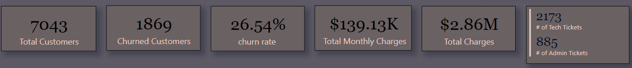
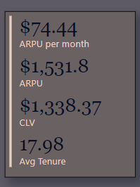
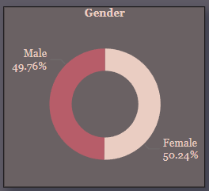
Understanding the Churn Problem
Churn Rate: 26.54% Financial Impact:
Total monthly charges: $456.12K
Churn customers generate: $139.13K
Total charges: $16.06M
Churn customers generate: $2.86M
Technical Support:
Tech tickets for churn customers: 2,173
Admin tickets: 885
Demographics:
Gender split: 50% male, 50% female
Average Revenue Per User (ARPU): $74.44
Average Revenue Per User (ARPU) per year: $1,531.80
Customer Lifetime Value (CLV): $1,338.37
Average tenure: 17.98 months
Notes:
Recommendation:
Prioritize High-Impact Areas: Focus retention efforts on areas with the highest financial impact to maximize the return on investment.
Tech and Admin Support: Increase investment in technical and administrative support to reduce the number of tickets and improve customer satisfaction.

Slide 5
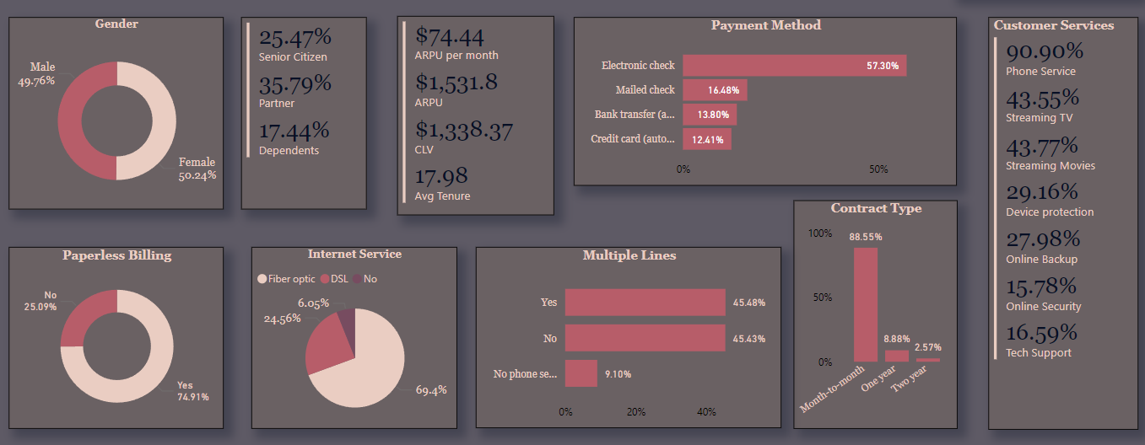
Customer Demographics and Preferences
Partner Status:
35.8% of churn customers have partners
25.47% are seniors
Billing Preferences:
75% prefer paperless billing
Internet Service:
69.4% use fiber optics
45% have multiple lines
10% do not have any phone service
Contract Type:
88.55% are on month-to-month contracts
Service Subscriptions:
90.9% have phone service
15.78% have online security service
16.59% have tech support service
Payment Method:
57.30% prefer electronic check payment
Notes:
Recommendation:
Target Seniors and Partnered Customers: Develop specialized retention programs for seniors and customers with partners.
Leverage Paperless Billing Preferences: Promote the benefits of paperless billing to engage the 75% of customers who prefer this method.
Focus on Fiber Optics Users: Improve service quality for the 69.4% of customers using fiber optics, as they represent a significant portion of the customer base.

Slide 6
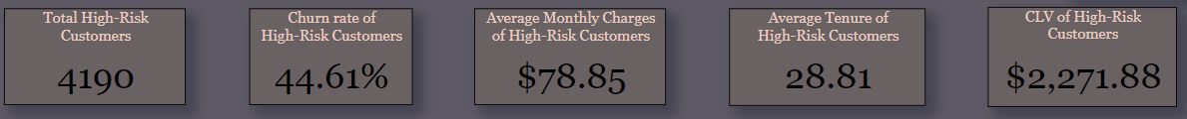
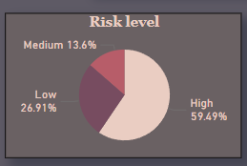
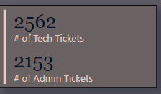
High-Risk Customers Overview
High-Risk Customers: 4,190 Definition: Customers who are churned, have a tenure of less than 6 months, or have monthly charges greater than $80
Churn Rate: 44.61% Financial Metrics:
Average monthly charges: $78.85
Average tenure: 28.81 months
Customer Lifetime Value (CLV): $2,272
Technical Support:
Tech tickets: 2,562
Admin tickets: 2,153
Risk Distribution:
High risk: 59.49%
Medium risk: 13.60%
Low risk: 26.91%
Notes:
Recommendation:
Engage High-Risk Customers: Implement proactive engagement strategies for the 4,190 high-risk customers to address their needs and reduce churn rates.
Focus on High Revenue Customers: Prioritize retention efforts on customers with high monthly charges and tenure to maximize financial benefits.

Slide 7
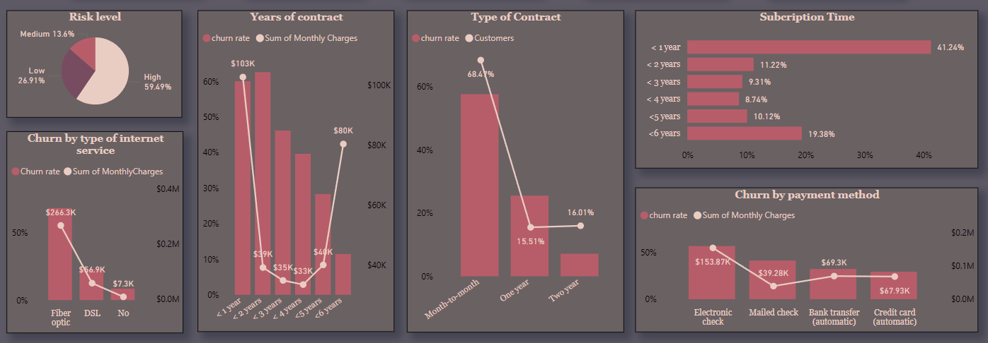
Detailed Analysis of High-Risk Customers
Internet Service:
Fiber optics generates total monthly charges of $266.3K
High churn rate of 68.5% among high-risk customers
Contract Length:
<1 year: 60% churn rate, generates over $100K in monthly charges
<6 years: 11.45% churn rate, generates over $80K in monthly charges
Contract Type:
Month-to-month: 57.7% churn rate, 2.9K customers
Loyalty:
<1 year: 41.24%
<6 years: 19.38%
Payment Method:
Electronic check: 57.18% churn rate, $153.8K in monthly charges
Credit card: 29.59% churn rate
Notes:
Recommendation:
Enhance Fiber Optics Service: Address issues related to fiber optics service to improve satisfaction and reduce churn.
Promote Long-Term Contracts: Encourage customers to switch from month-to-month to longer-term contracts by offering incentives and benefits.
Offer Stable Payment Options: Encourage the use of more stable payment methods like credit cards or bank transfers to reduce churn associated with electronic checks.

Slide 8
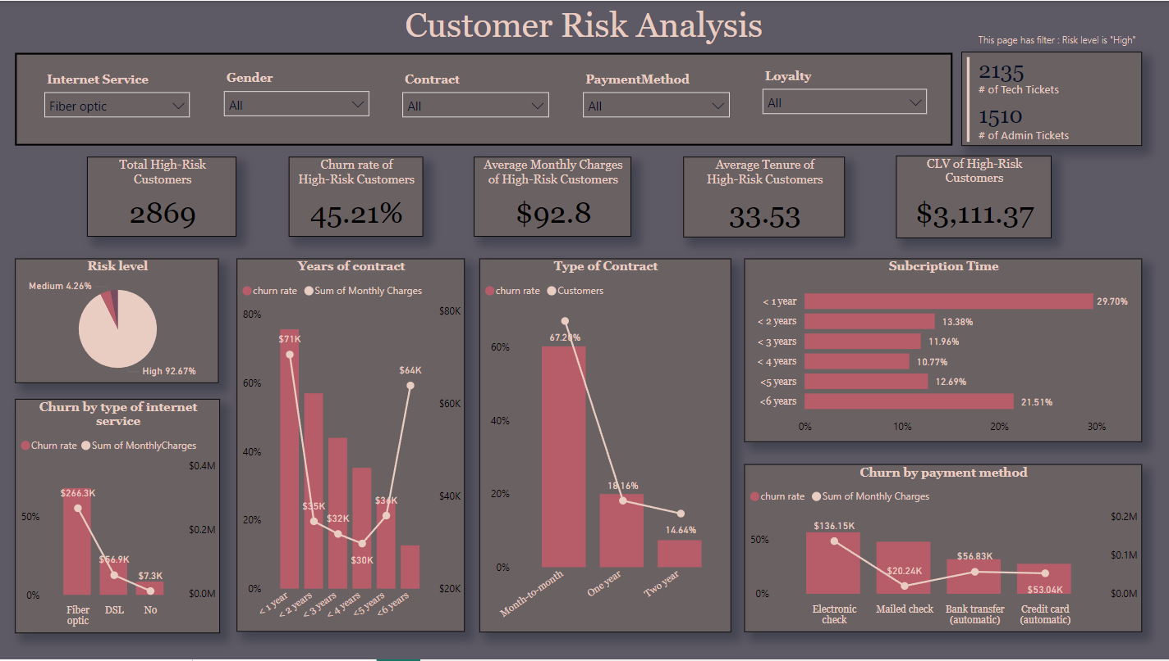
Fiber Optics High-Risk Customers
High-Risk Customers: 92.67% Churn Rate: 45.21% Financial Metrics:
Average monthly charge: $92.8
Average tenure: 33.53 months
Customer Lifetime Value (CLV): $3,111.37
Technical Support:
Tech tickets: 2,135
Admin tickets: 1,510
Payment Method:
Electronic check: 56.49% churn rate
Credit card: 27.55% churn rate
Contract Length:
<1 year: 75.70% churn rate, $71K in monthly charges
<6 years: 12.64% churn rate, $64K in monthly charges
Contract Type:
Month-to-month: 60.27% churn rate, 67.2% of customers
2-year contract: 7.38% churn rate, 14.64% of customers
Notes:
Recommendation:
Improve Fiber Optics Reliability: Invest in improving the reliability and performance of fiber optics service to meet customer expectations.
Contract Extension Offers: Provide attractive offers for customers to extend their contracts beyond the initial term.
Dedicated Support for Fiber Optics: Offer dedicated support channels for fiber optics customers to resolve issues quickly and enhance satisfaction.

Slide 9
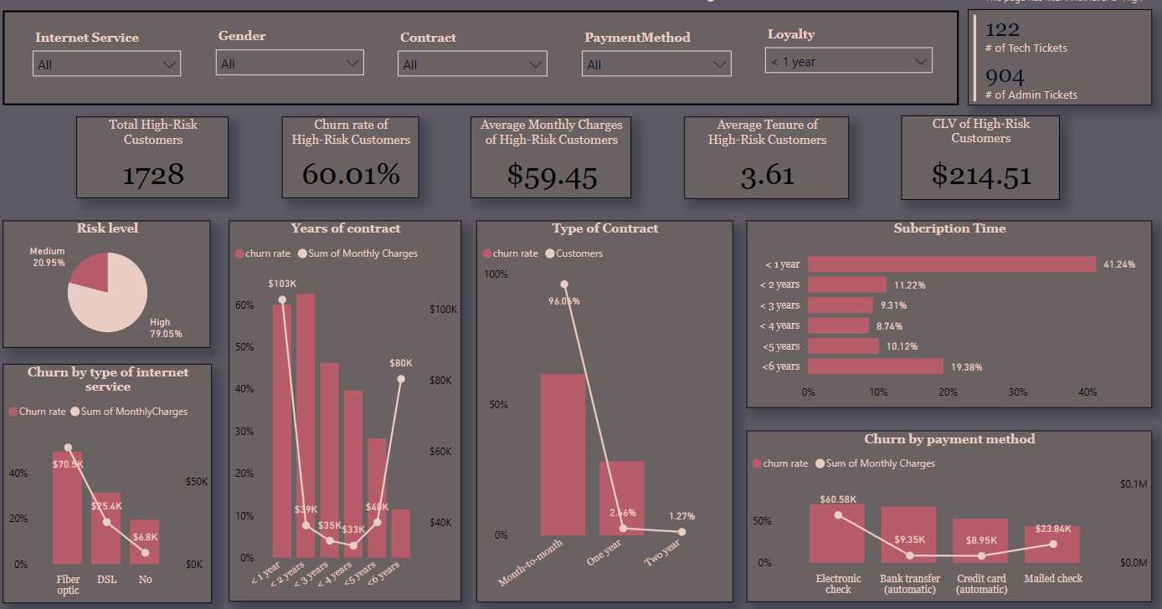
High-Risk Customers with <1 Year Contract
High-Risk Customers: 79.05% Churn Rate: 60.01% Financial Metrics:
Average monthly charges: $59.45
Average tenure: 3.61 months
Customer Lifetime Value (CLV): $214.51
Technical Support:
Tech tickets: 122
Admin tickets: 904
Internet Service:
Fiber optics: 49.31% churn rate
Contract Type:
Month-to-month: 96.06% of customers, 61.69% churn rate
Payment Method:
Electronic check: 70.38% churn rate
Notes:
Recommendation:
Early Engagement Programs: Implement programs to engage new customers early in their contract period to build loyalty and reduce churn.
Incentives for Contract Extension: Offer incentives such as discounts or additional services to encourage customers to extend their contracts beyond one year.
Regular Check-Ins: Schedule regular check-ins with customers during their first year to address any concerns and improve their experience.

Slide 10
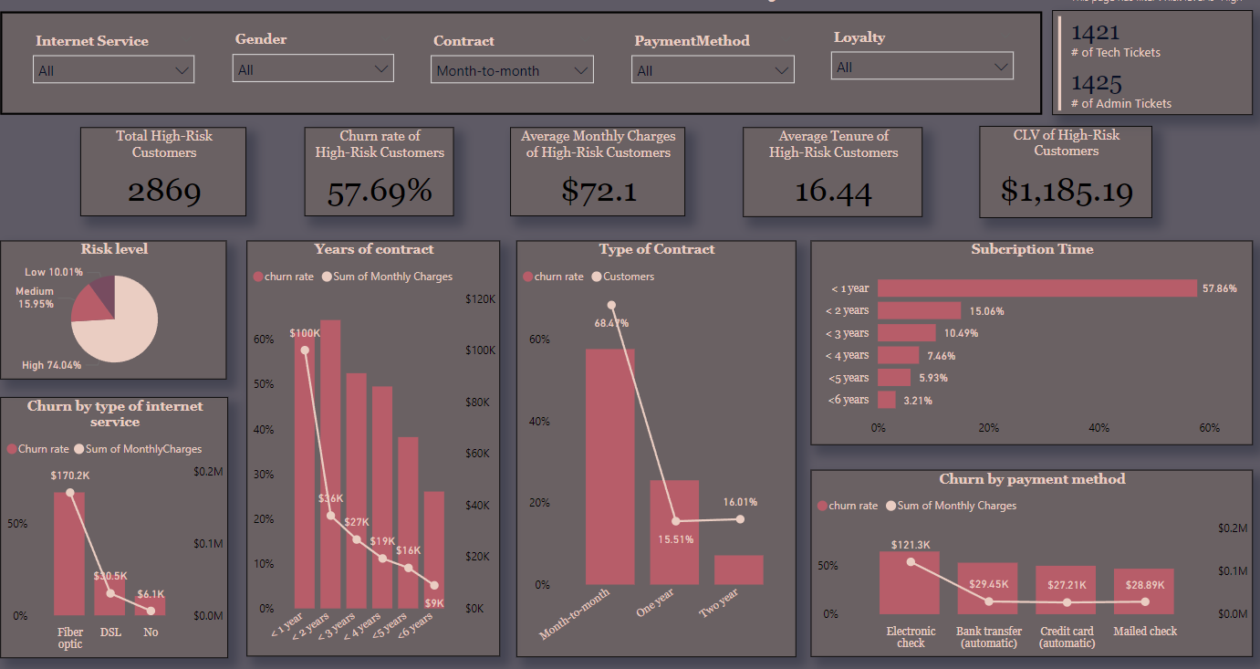
High-Risk Customers with Month-to-Month Contract
High-Risk Customers: 74.04% Churn Rate: 57.69% Financial Metrics:
Average monthly charges: $72.1
Average tenure: 16.44 months
Customer Lifetime Value (CLV): $1,185.19
Internet Service:
Fiber optics: 67.20% churn rate, $170K in monthly charges
Loyalty:
<1 year: 57.86% of customers, 61.69% churn rate, $100K in monthly charges
Payment Method:
Electronic check: 64.76% churn rate
Notes:
Recommendation:
Promote Long-Term Benefits: Highlight the benefits of long-term contracts, such as cost savings and additional features, to encourage month-to-month customers to switch.
Flexible Contract Options: Provide flexible contract options that allow customers to easily transition to longer-term commitments.
Loyalty Rewards for Switching: Implement loyalty rewards programs that offer benefits for customers who switch to annual or bi-annual contracts.

Slide 11
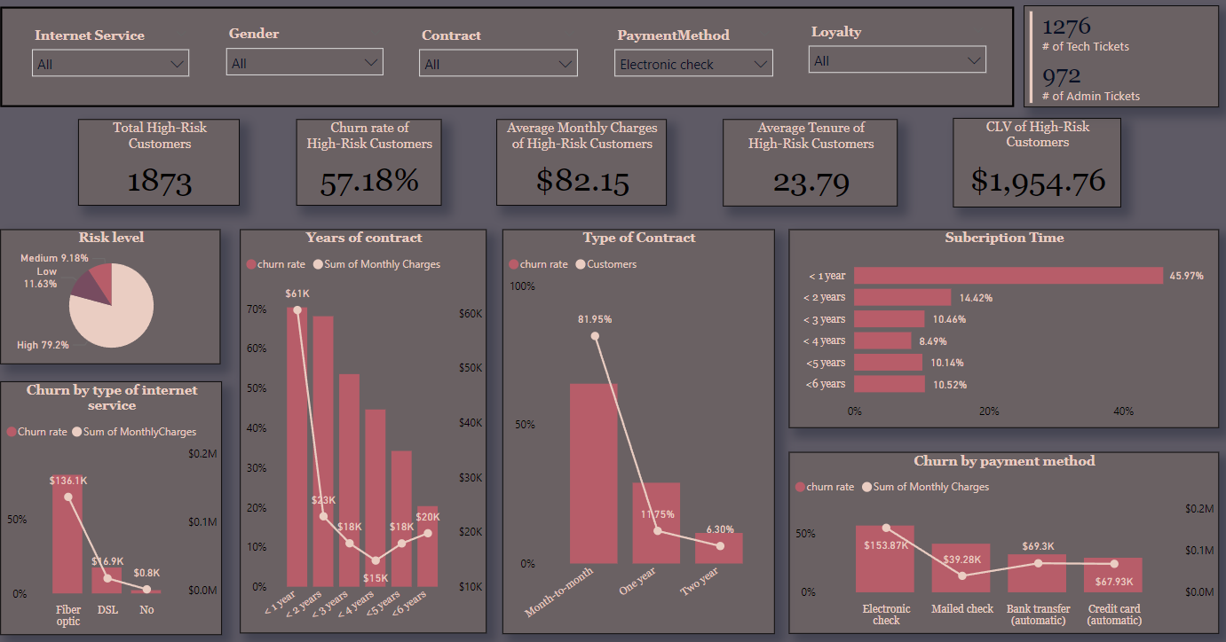
High-Risk Customers with Electronic Check Payment Method
High-Risk Customers: 79.2% Churn Rate: 57.18% Financial Metrics:
Average monthly charges: $82.15
Average tenure: 23.79 months
Customer Lifetime Value (CLV): $1,954.76
Technical Support:
Tech tickets: 1,276
Admin tickets: 972
Internet Service:
Fiber optics: 80.25% churn rate, $136K in monthly charges
Contract Length:
<1 year: 45.97% of customers, 70.38% churn rate, $61K in monthly charges
Contract Type:
Month-to-month: 64.76% churn rate, 81.95% of customers
Notes:
Recommendation:
Incentives for Stable Payments: Offer incentives such as discounts or loyalty points for customers who switch to more stable payment methods like credit cards or bank transfers.
Educate on Payment Benefits: Educate customers about the benefits and security of more stable payment methods to encourage switching.
Flexible Payment Plans: Provide flexible payment plans to accommodate different customer preferences and reduce churn.

Slide 12
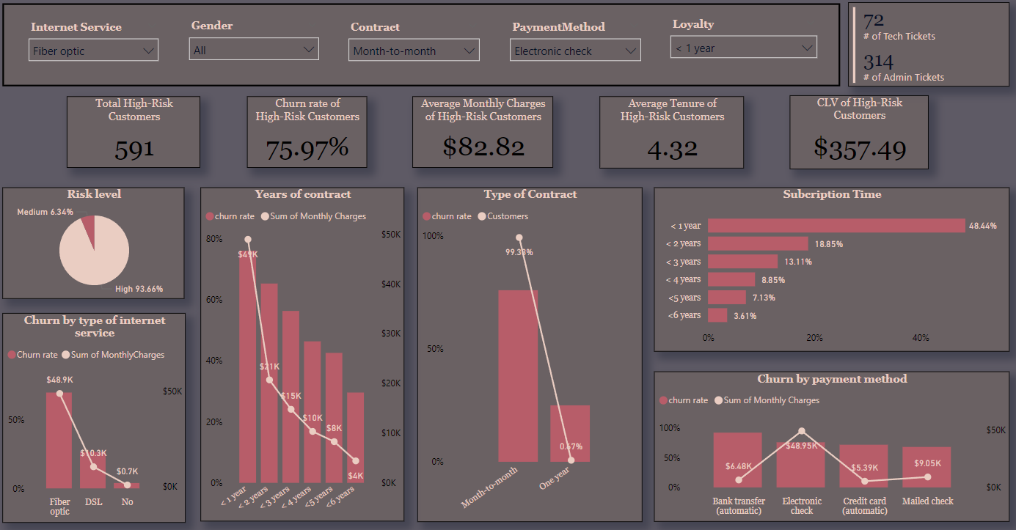
High-Risk Customers with Fiber Optics, Month-to-Month Contract, Electronic Check Payment & <1 Year Contract
High-Risk Customers: 93.66% Churn Rate: 75.97% Financial Metrics:
Average monthly charges: $82.82
Average tenure: 4.32 months
Customer Lifetime Value (CLV): $357.49
Technical Support:
Tech tickets: 72
Admin tickets: 314
Internet Service:
Fiber optics: 69.61% churn rate, $48.9K in monthly charges
Loyalty:
<1 year: 48.44% of customers, 75.97% churn rate
Contract Type:
Month-to-month: 99.38% of customers, 75.97% churn rate
Payment Method:
Bank transfer: 92.21% churn rate, $6.48K in monthly charges
Electronic check: 76% churn rate, $48.95K in monthly charges
Notes:
Recommendation:
Comprehensive Retention Packages: Develop comprehensive retention packages that include service improvements, long-term contract incentives, and stable payment options.
Targeted Communication Strategies: Use targeted communication strategies to engage this high-risk segment with personalized offers and support.
Proactive Outreach Programs: Implement proactive outreach programs to address concerns and provide solutions before customers consider leaving.

Slide 13

Retention Strategies
Strategy 1: Offer Incentives for Long-Term Contracts
Provide discounts or additional services for customers who switch from month-to-month to annual or bi-annual contracts.
Strategy 2: Improve Service Quality and Support
Increase investment in tech support and online security services to reduce tech and admin tickets.
Offer personalized support for customers with high numbers of tickets.
Strategy 3: Enhance Customer Engagement
Implement targeted communication strategies to engage customers with high churn risks.
Use personalized offers based on customer data and preferences.
Strategy 4: Optimize Payment Methods
Encourage customers to switch to more stable payment methods such as credit cards or bank transfers.
Strategy 5: Introduce Loyalty Programs
Develop loyalty programs to reward long-term customers and reduce churn.
Strategy 6: Continuous Monitoring and Improvement
Regularly analyze customer data to identify emerging churn risks and adjust strategies accordingly.
Notes:
Recommendation:
Offer Incentives for Long-Term Contracts: Provide discounts or additional services for customers who switch from month-to-month to annual or bi-annual contracts.
Improve Service Quality and Support: Increase investment in tech support and online security services to reduce tech and admin tickets and improve customer satisfaction.
Enhance Customer Engagement: Implement targeted communication strategies to engage customers with high churn risks and use personalized offers based on customer data and preferences.
Optimize Payment Methods: Encourage customers to switch to more stable payment methods such as credit cards or bank transfers.
Introduce Loyalty Programs: Develop loyalty programs to reward long-term customers and reduce churn.
Continuous Monitoring and Improvement: Regularly analyze customer data to identify emerging churn risks and adjust strategies accordingly.

Slide 14

Implementation Timeline
Month 1-2:
Phase 1: Analyze current customer data and segment high-risk customers.
Phase 2: Develop detailed action plans for each retention strategy.
Month 3-4:
Phase 3: Launch pilot programs for long-term contract incentives and enhanced support services.
Phase 4: Implement targeted communication strategies for high-risk customers.
Month 5-6:
Phase 5: Roll out optimized payment methods and loyalty programs.
Phase 6: Collect feedback and data from initial implementations and make adjustments.
Month 7-8:
Phase 7: Expand successful pilot programs across all customer segments.
Phase 8: Continuously monitor customer data and adjust retention strategies as needed.
Month 9-12:
Phase 9: Conduct a comprehensive review of the implemented strategies.
Phase 10: Develop new initiatives based on the review and continue the cycle of monitoring and improvement.
Notes:
Recommendation:
Phase Implementation: Implement strategies in phases to manage resources effectively and measure the impact of each initiative.
Monitor and Adjust: Continuously monitor the progress of each phase and make necessary adjustments based on feedback and data analysis.
Engage Stakeholders: Ensure all stakeholders are engaged and informed throughout the implementation process to maintain alignment and support.

Slide 15
Loyalty Programs & Continuous Improvement
Loyalty Programs:
Reward long-term customers with exclusive offers, discounts, and services.
Introduce tiered loyalty levels to incentivize continued engagement.
Continuous Improvement:
Regularly update and refine retention strategies based on customer feedback and data analysis.
Stay ahead of industry trends and customer expectations.
Notes:
Recommendation:
Develop Loyalty Programs: Reward long-term customers with exclusive offers, discounts, and services to enhance loyalty and reduce churn.
Tiered Loyalty Levels: Introduce tiered loyalty levels to incentivize continued engagement and provide added value to loyal customers.
Continuous Improvement: Regularly update and refine retention strategies based on customer feedback and data analysis to stay ahead of industry trends and customer expectations.

Slide 16
Conclusion
Summary: The presentation provides a detailed analysis of customer churn and outlines effective strategies to reduce churn rates and increase customer retention. It highlights the importance of understanding customer demographics and preferences, identifies high-risk segments, and recommends targeted retention strategies.
Overall Conclusion:
Data-Driven Strategies: Use customer data to identify high-risk segments and tailor retention strategies accordingly.
Personalization and Engagement: Develop personalized retention programs that align with customer needs and preferences.
Incentives and Support: Offer incentives for long-term contracts, improve service quality, and provide proactive customer support.
Payment Optimization: Encourage stable payment methods to reduce churn associated with payment issues.
Continuous Improvement: Regularly monitor and adjust retention strategies based on customer feedback and data analysis.
Combined Recommendation:
Immediate Action: Implement targeted retention strategies for high-risk segments immediately to prevent further churn.
Long-Term Planning: Develop a comprehensive retention plan that includes regular monitoring, customer engagement, and continuous improvement initiatives.
Stakeholder Collaboration: Engage stakeholders across the organization to ensure alignment and support for retention initiatives.

Slide 17

Thank you!
Connect via:
Email: rupsachaudhuri9@gmail.com
LinkedIn
GitHub

